Slide 1
Optimizing the Student Experience
Midge Bowers & Beth Phillips

Slide 2
Objectives
Describe the ways to optimize the student clinical experience
Explore the differences in students today
Examine the changes in today’s healthcare system that impact student learning
Discuss strategies to push the envelope for optimization of the student experience
Undergraduate students
Graduate students

Slide 3

The differences in students today: Greetings, Gizmos, Google……….

Slide 4

Student Differences
Learner Attributes
Preferences
Aspirations
Resources
Experience
Learner Variances
Age
Culture
Ethnicity
Gender
Motivation
Socioeconomic Status
Anderson, 2016; Beetham & Sharpe, 2013; Bowen & McPherson, 2016; Merriam & Bierema, 2014)

Slide 5
Changes in today’s healthcare system
Evidence based practice
Changing demographics of nurses; staff and faculty
Technology, EHR, patient acuities, staff ratios
Sicker people at home or LTC, polypharmacy, value-based care vs volume
Fees for placements, lack of clinical sites, simulation substitution
High expectations for pursuing higher education and its relationship to quality patient care and outcomes

Slide 6
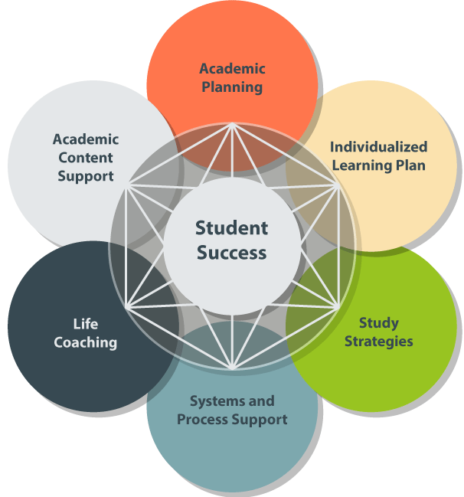
Strategies for Student Success
Undergraduate
Graduate

Slide 7
Strategies for Student Success

Slide 8
Strategies for Student Success

Slide 9
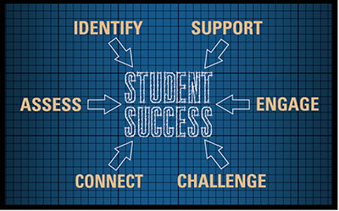
Strategies for Student Success

Slide 10
Strategies for Student Success
Determine how your students learn best
Help them set realistic goals
Help them identify an accountability partner
Make it personal!
Chambliss, 2014; Thomas, McIntosh, & Mensik, 2016

Slide 11
Strategies for Student Success
Address poor academic performance early
Identify poor attendance and study skills
Notice minimal social support
Help with lack of time management skills
Look for solutions to financial barriers
Provide adequate information regarding academic support services
Welcome and support cultural differences in your students

Slide 12
Summary- Objectives Met
Describe the ways to optimize the student clinical experience
Explore the differences in students today
Examine the changes in today’s healthcare system that impact student learning
Discuss strategies to push the envelope for optimization of the student experience

Slide 13
Questions?
Thank you!
Midge and Beth

Slide 14
References
Anderson, I. (2016). Identifying different learning styles to enhance the learning experience.
Nursing Standard, 31(7), 53-63. doi:10.7748/ns.2016.e10407
Beetham, H., & Sharpe, R. (2013). Rethinking pedagogy for a digital age: Designing for 21st
century learning. Hoboken, JM: Taylor & Francis.
Bowen, W.G. & McPherson, M.S. (2016). Lesson Plan: An agenda for change in American higher
education. Princeton, New Jersey; Princeton University Press.
Chambliss, D.F. (2014). The power of the personal. The Chronical of Higher Education. Retrieved
from https://www.chronicle.com/article/The-Power-of-the-Personal/148743
Merriam, S. & Bierema, L.L. (2014). Adult Learning: Linking Theory and Practice. San Francisco,
Ca, Wiley & Sons.
Thomas, CM, McIntosh, CE and Mensik, JS. (2016). Strategies for pursuing a master’s degree.
Dimensions of Critical Care Nursing 35(3): 147-153.

