Slide 1
Digital Health
Ryan J Shaw, PhD RN
Associate Professor
Faculty Director, Duke Mobile App Gateway
School of Nursing & School of Medicine
Duke University

Slide 2
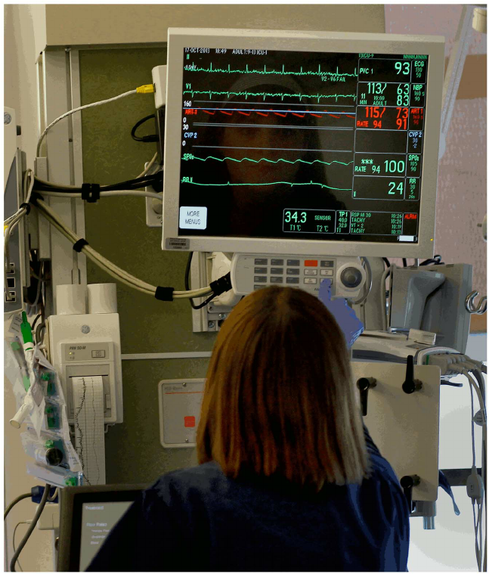

Slide 4
Precision Health
Today: most healthcare is based on expected response of the average patient
Tomorrow: healthcare will be based on individual genomic, environmental, and lifestyle differences that enable more precise ways to prevent and treat disease
Notes:
Develop quantitative estimates of risk for a range of diseases by integrating environmental exposures, genetic factors, and gene-environment interactions, identification of determinants of individual variation in efficacy and safety of commonly used therapeutic, discovery of biomarkers that identify people at increased or decreased risk of developing diseases

Slide 5
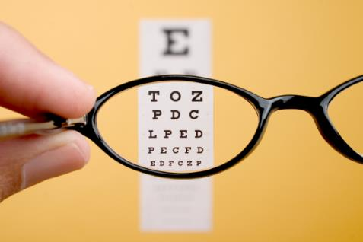
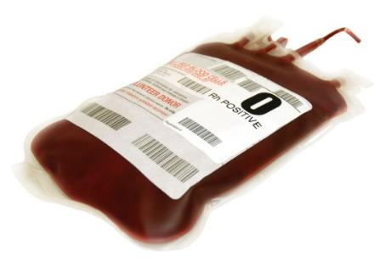
Precision Health
Eric Green, MD, PhD – NIH NHGRI
Notes:
Also used in prenatal and newborn genomic analysis
Cancer genome sequencing
Ultra-rare genetic disease diagnostics

Slide 6
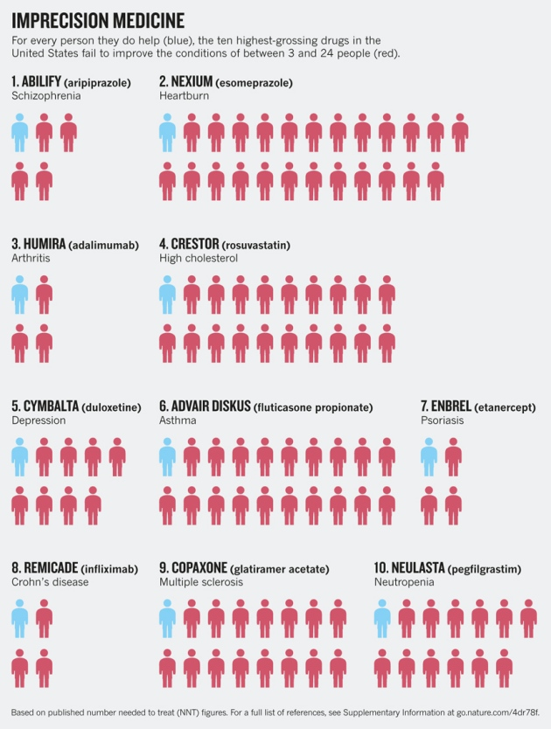
Notes:
Also used in prenatal genome sequencing

Slide 7
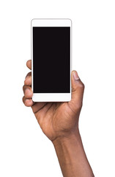
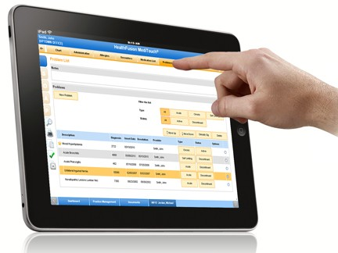
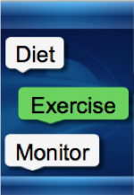

Slide 9
Mobile Health
MOBILE PHONES
> 96% of US population (88%Rural)
>95% <$30,000/year
>81% of US population have a smart phone (71% rural)
Socioeconomic backgrounds
Most Geographic locations
Direct reach
Pew 2019
Notes:
Mobile phones, particularly smartphones (sophisticated internet-accessible cellular phones) and other mobile computing technologies are increasingly ubiquitous
Over 285 million wireless subscribers in the US alone and over 67% of adults worldwide own a cell phone.
This is in contrast to the Internet digital divide, that limited for years if not decades, the reach of computerized health behavior interventions for lower socioeconomic groups.
Mobile phones are widely used among all demographic groups.
The infrastructure exists. 96% of the US is covered by at least one mobile network including rural areas
This allows reach across geographic location, socioeconomic backgrounds, and direct access to people

Slide 10
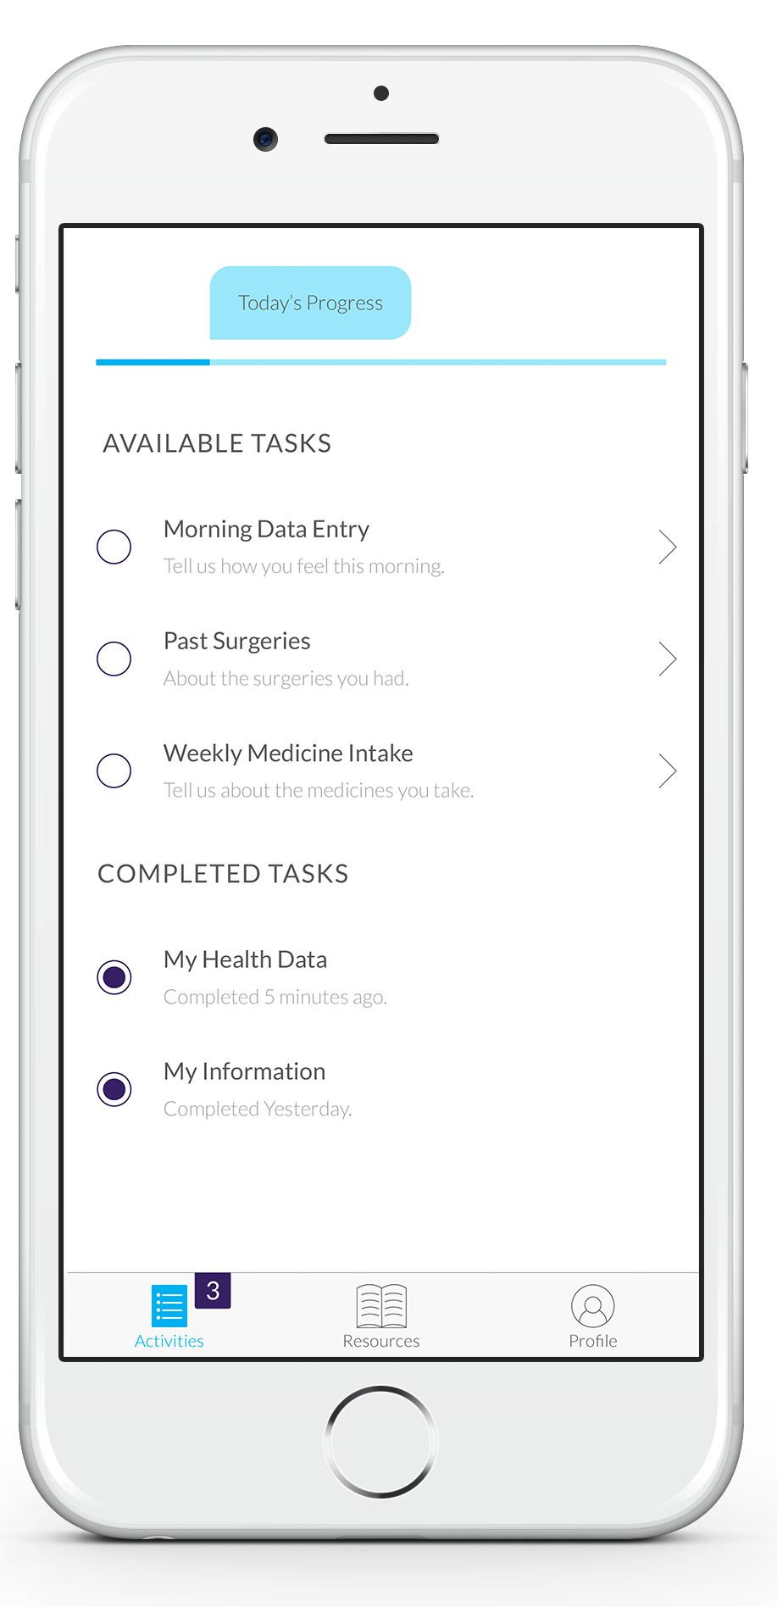
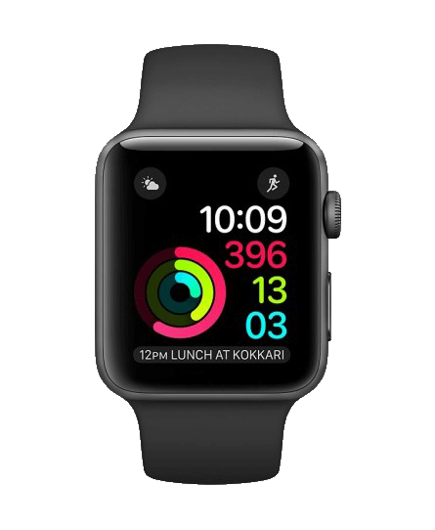
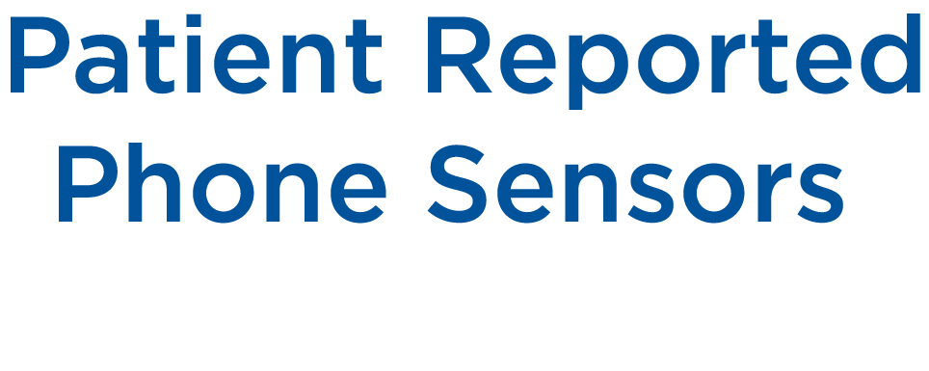

Slide 11
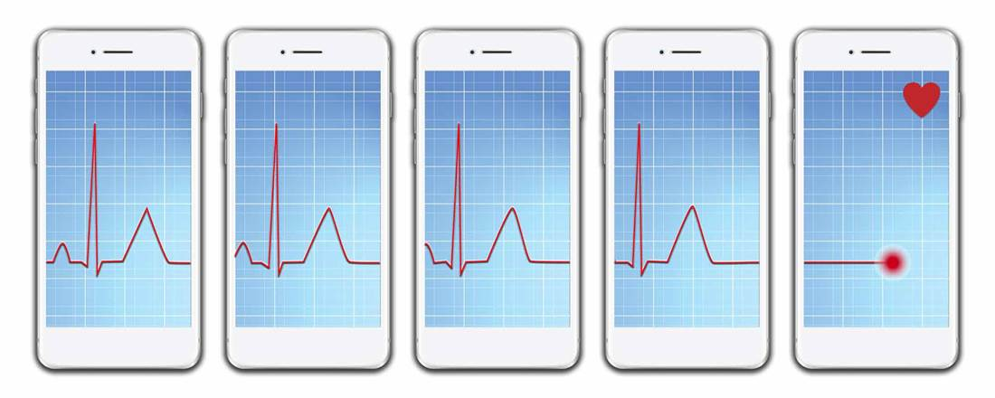

Slide 12
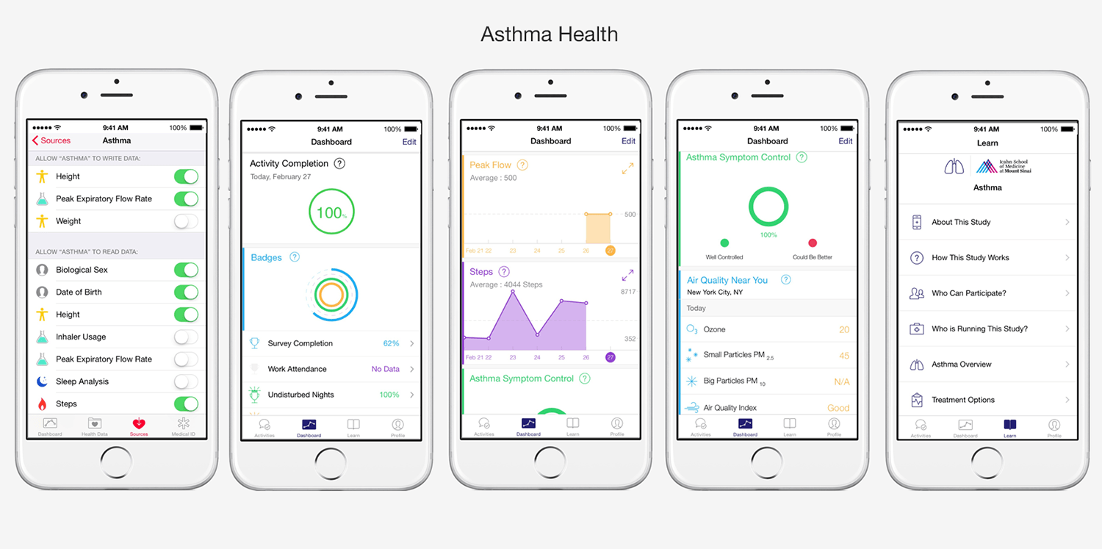

Slide 13
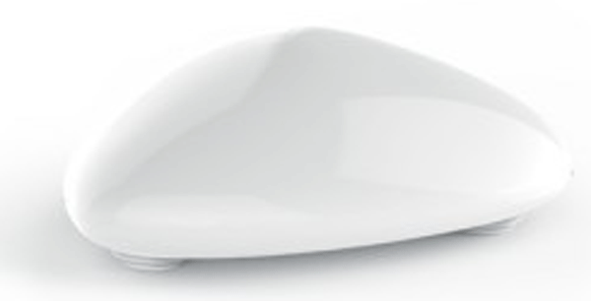
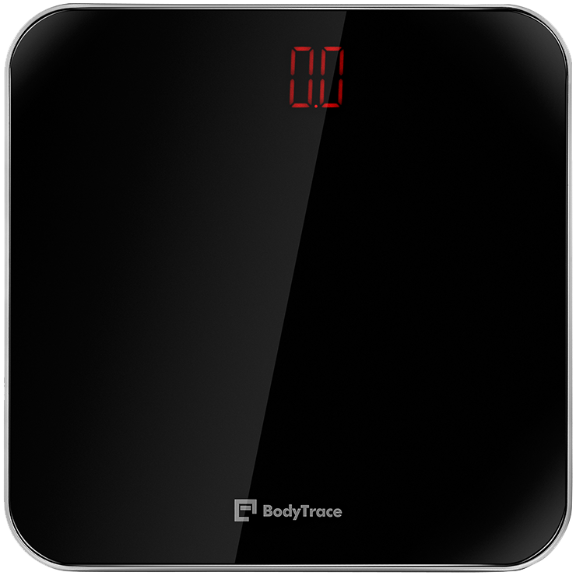
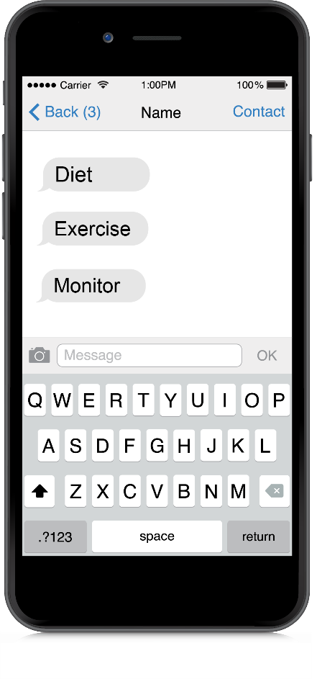
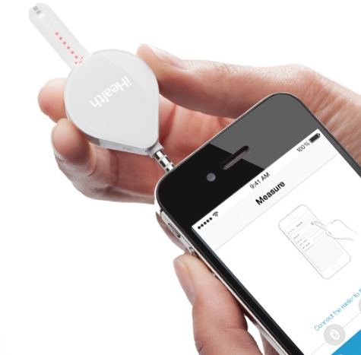
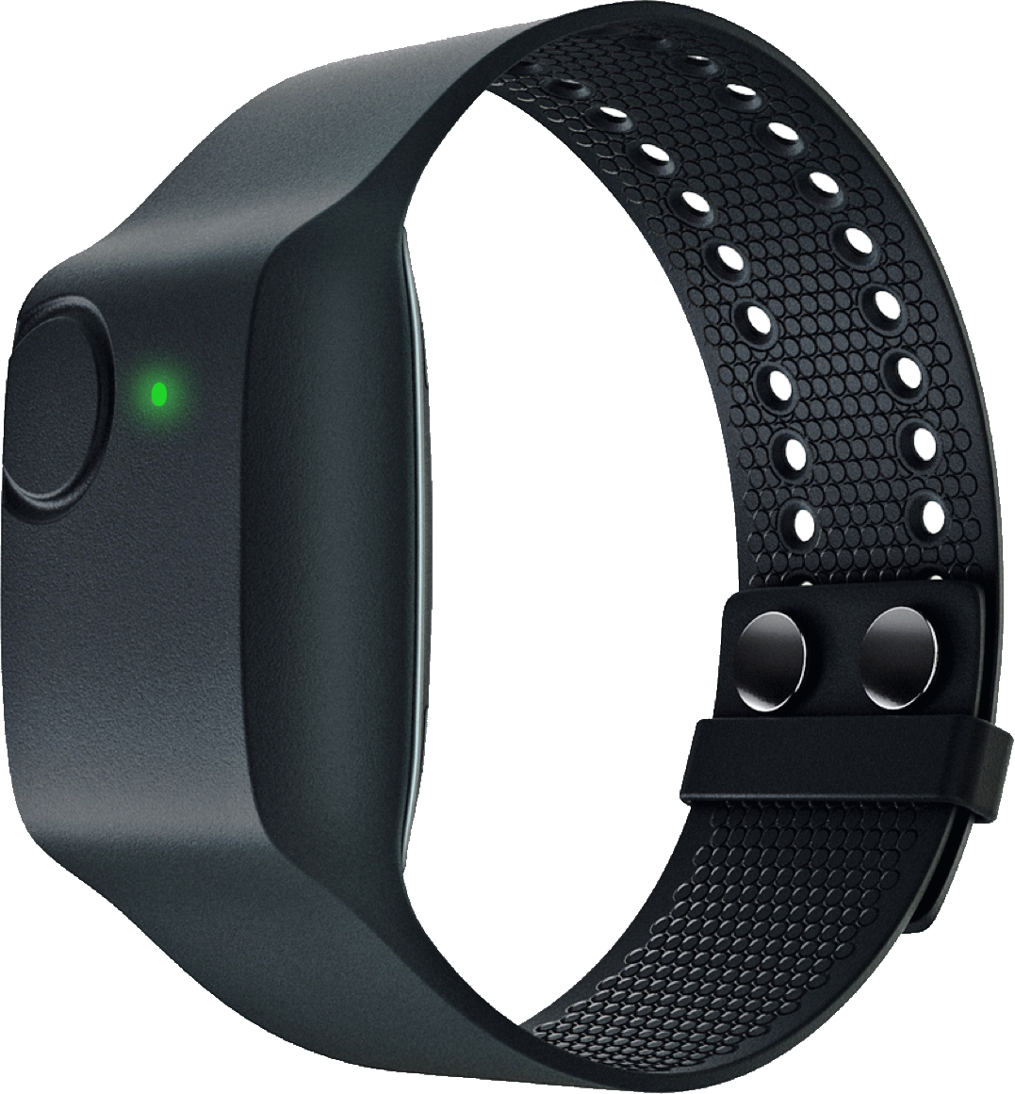

Slide 14
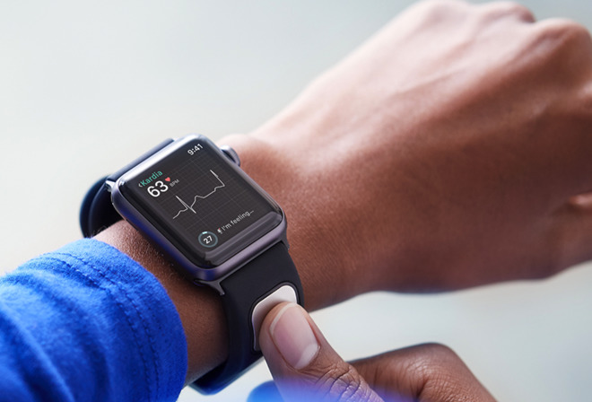

Slide 15
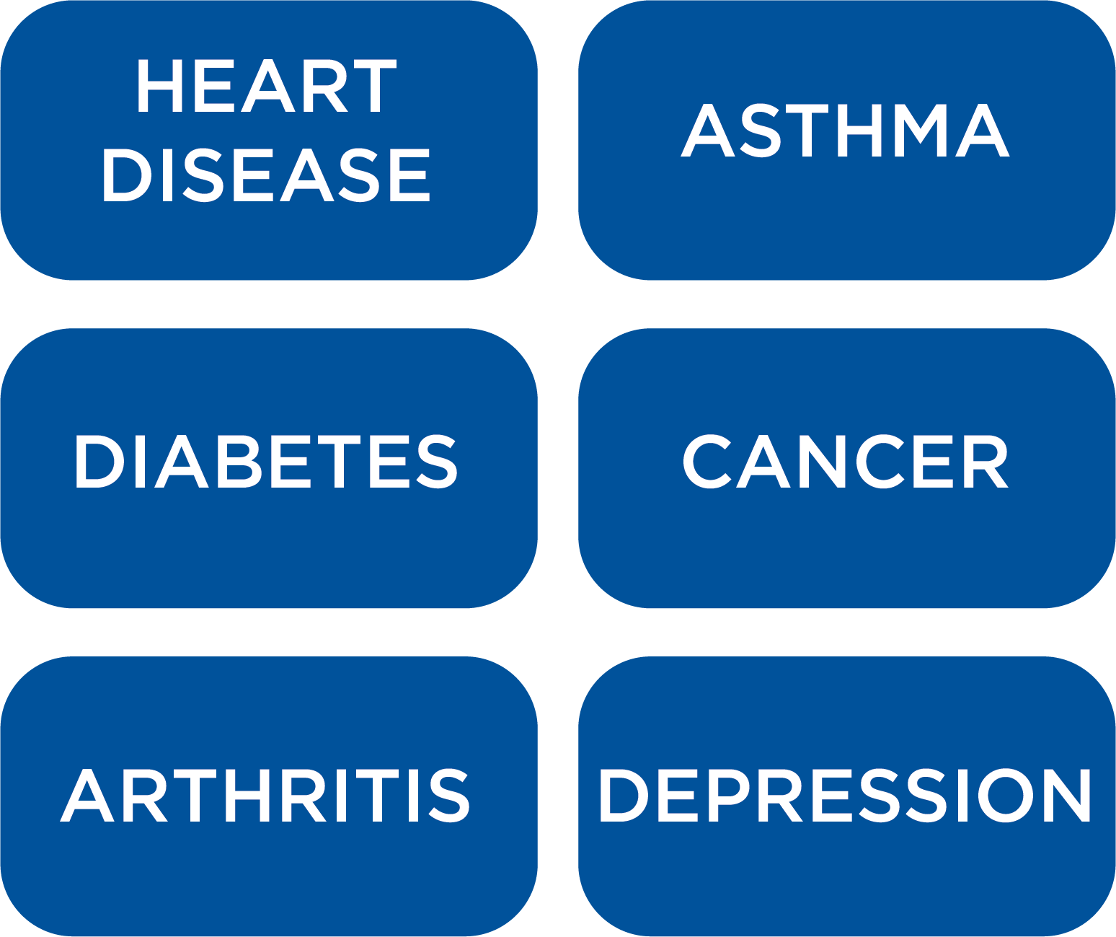
Notes:
mHealth may be particularly useful for chronic illness
Chronic illness is the #1 health risk facing Americans. Approximately 50% of Americans have a chronic illness
Leading cause of death and disability
Acute -> chronic illness + extended life span = costly health care system
Diabetes will become the most costly disease by 2020
Chronic illness is very difficult to manage. It requires daily if not hourly behavior change. i.e. exercise, diet, medication management, conscious choices
mHealth may have significant impact on chronic illness management

Slide 16
Examples: Clinical, Research & Education

Slide 17
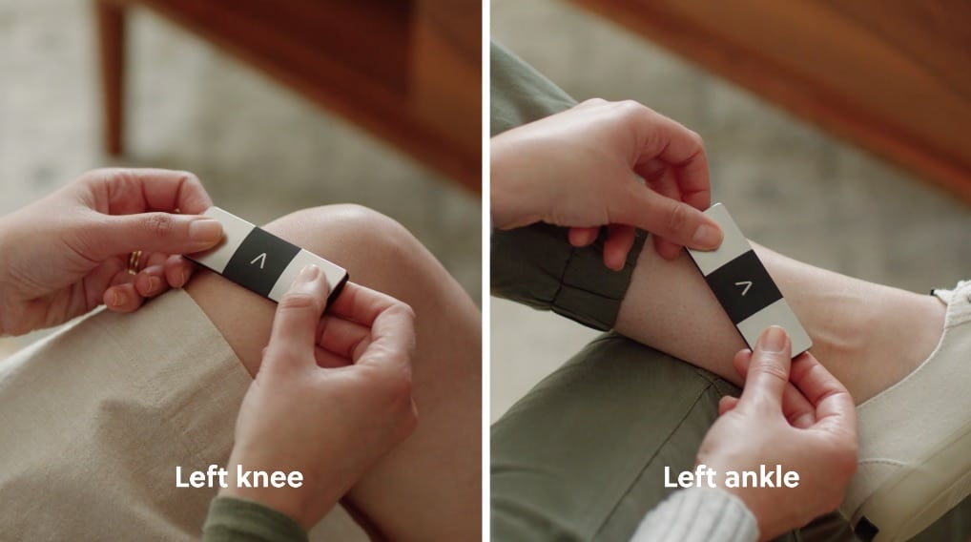
KardiaMobile 6L
FDA-cleared Personal 6-lead ECG

Slide 18
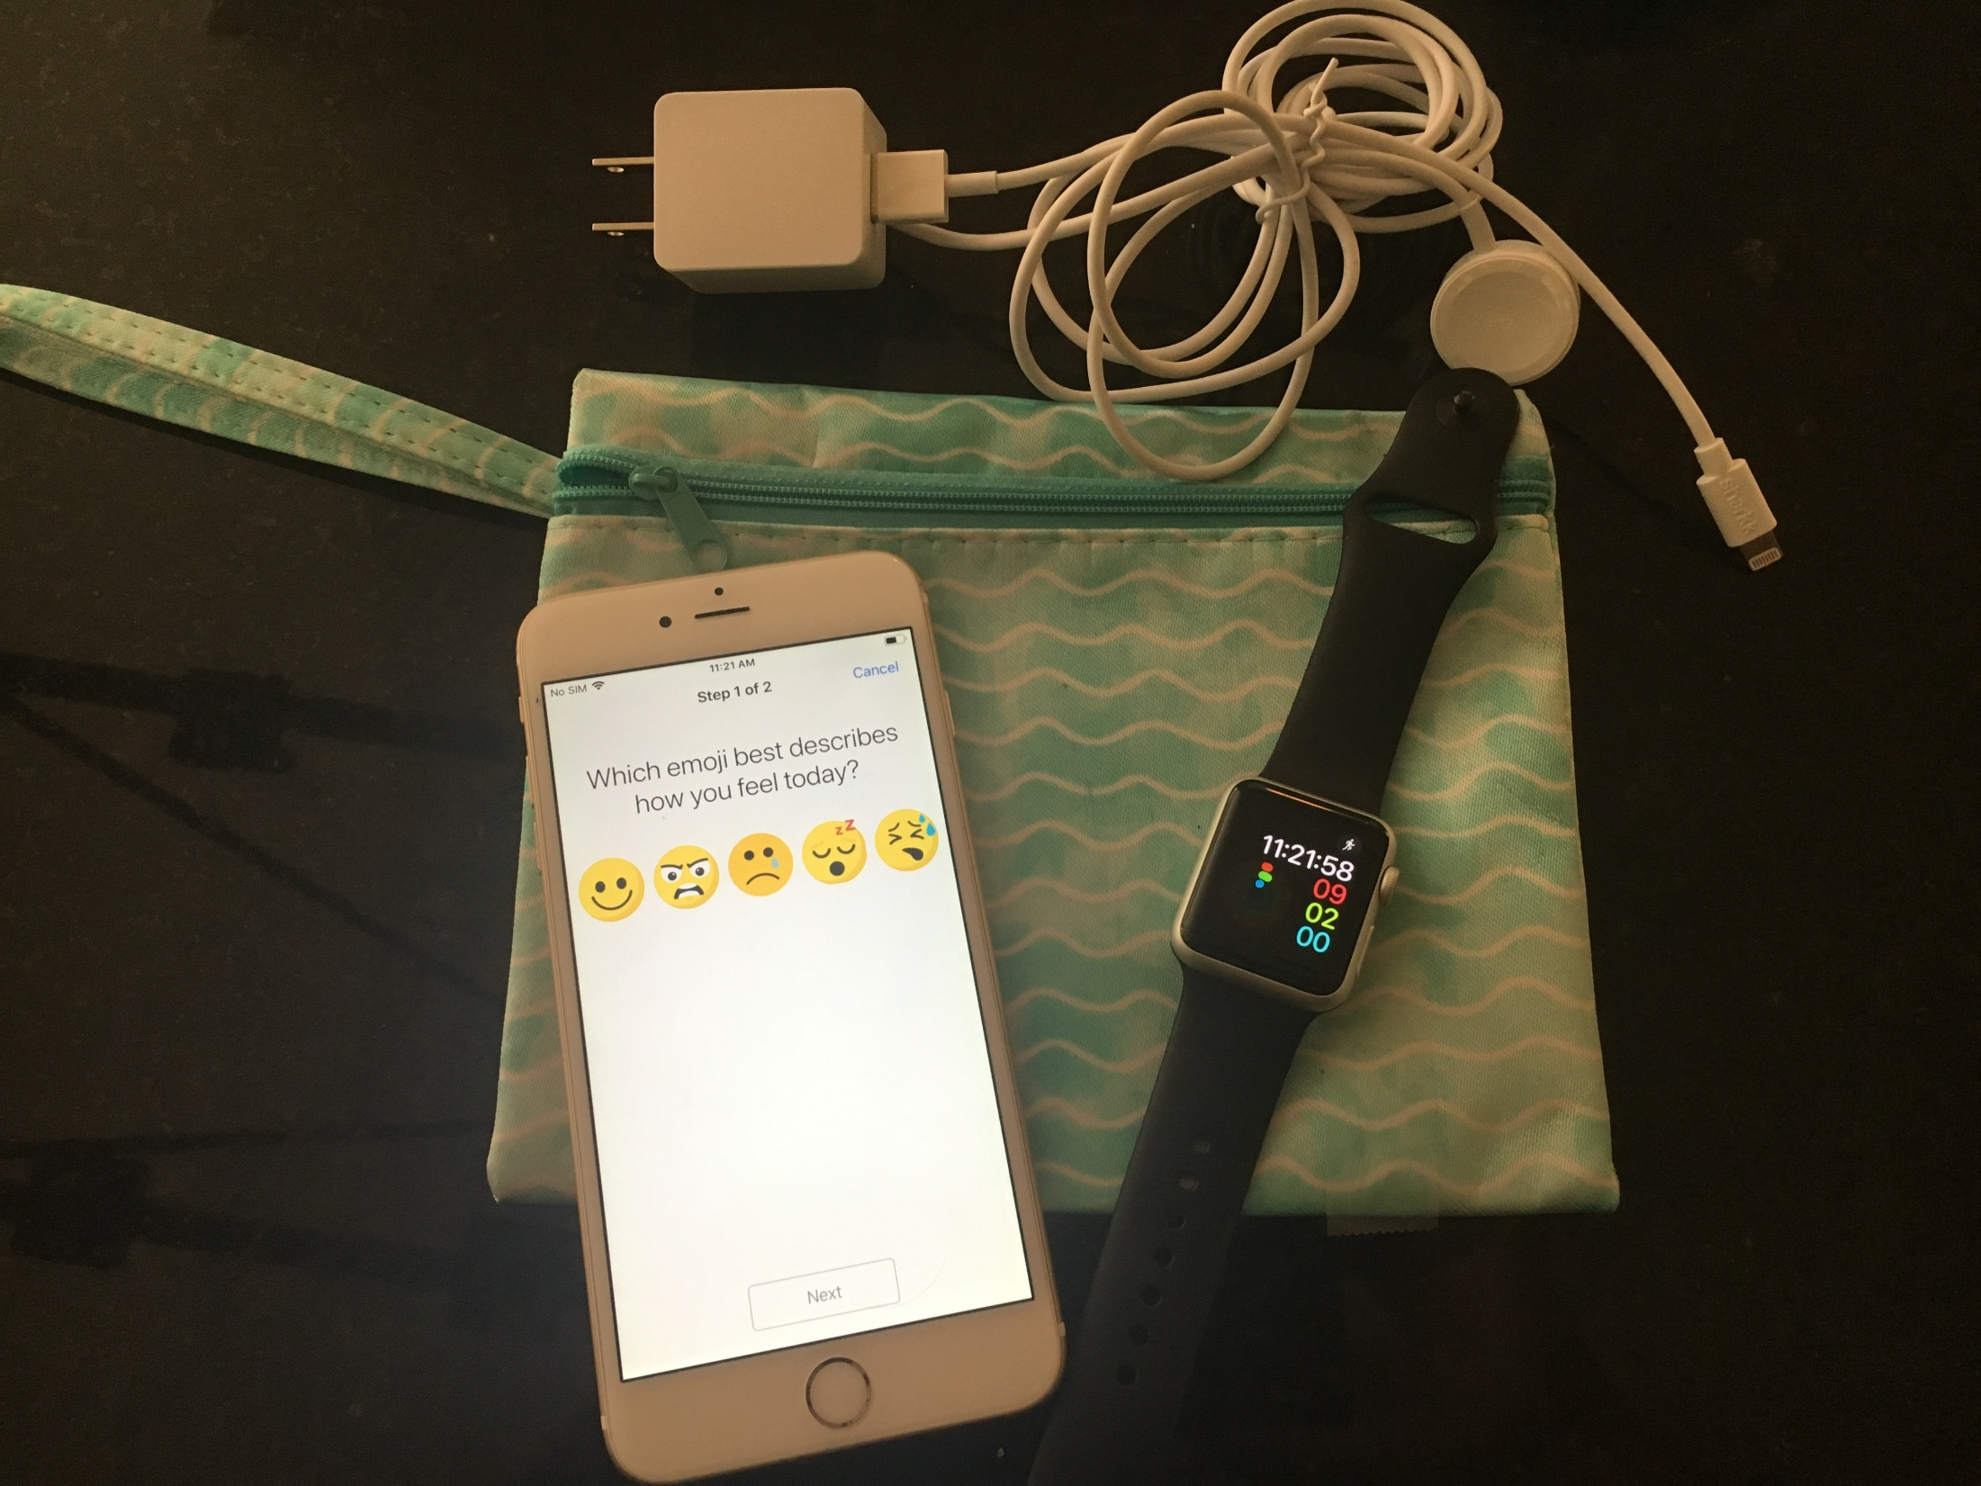
NINR F31NR018100 - Vaughn

Slide 19
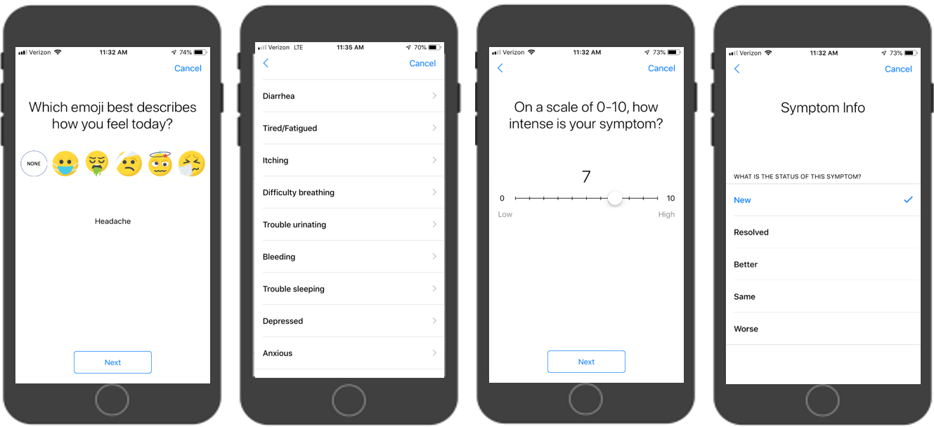
Pediatric PBMT
Vaughn, 2019
NINR F31NR018100 - Vaughn

Slide 21
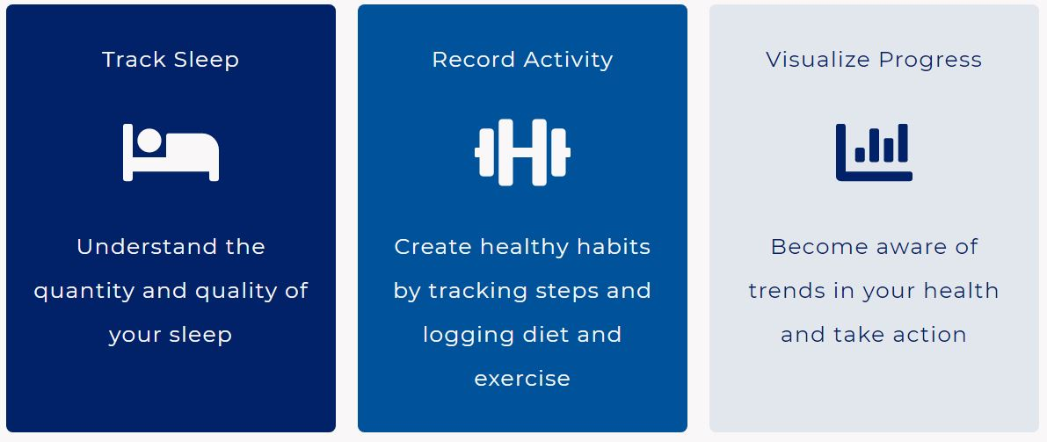
PI: Susanne Haga, PhD

Slide 22
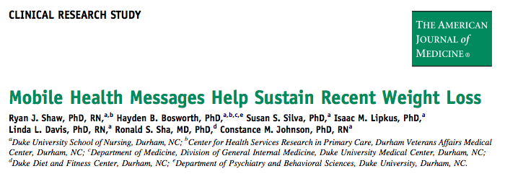
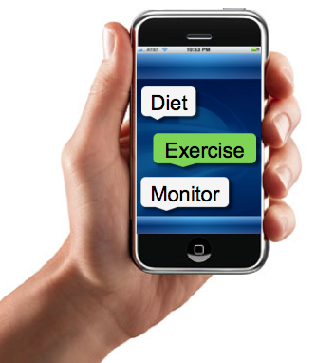
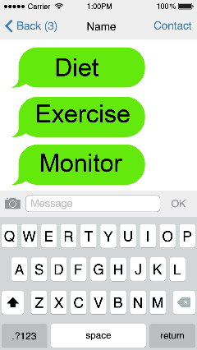
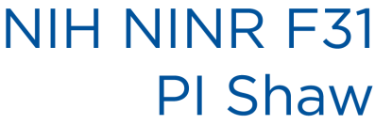

Slide 24
Partner2Lose: Using Partners to Enhance Long-Term Weight Loss
NIDDK 1R01DK111491
PI: Voils
Site PI: Shaw
Initiation: 6 Months
Maintenance: 18 months
24 Months

Slide 26
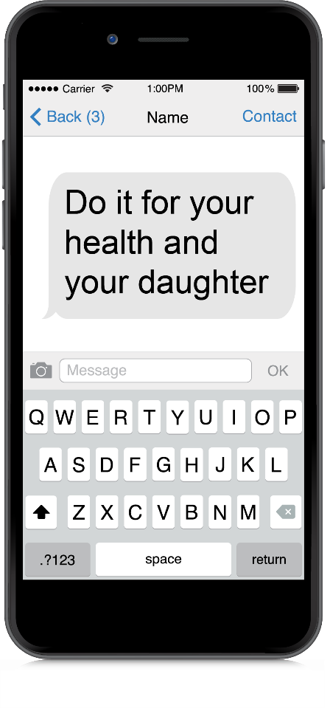
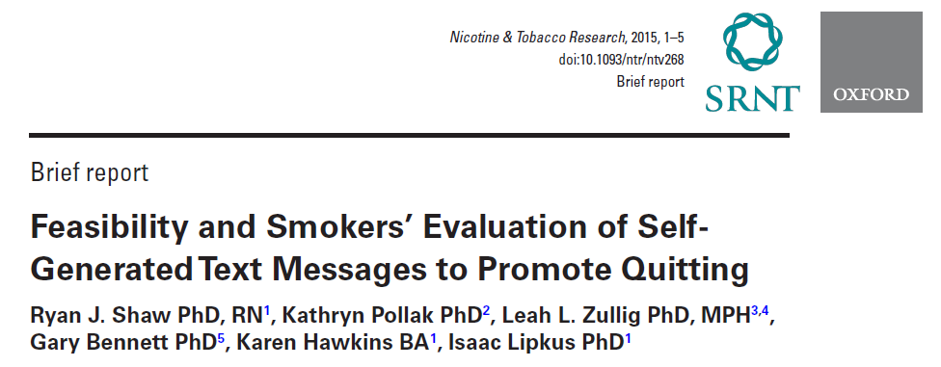
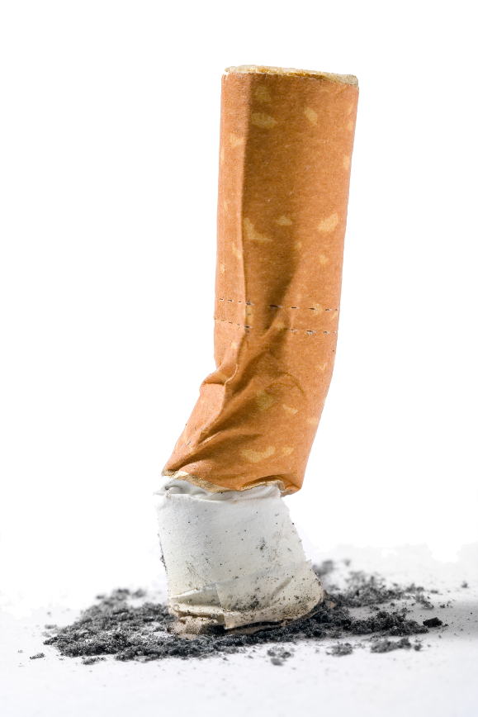
Do it for your health and your daughter

Slide 27
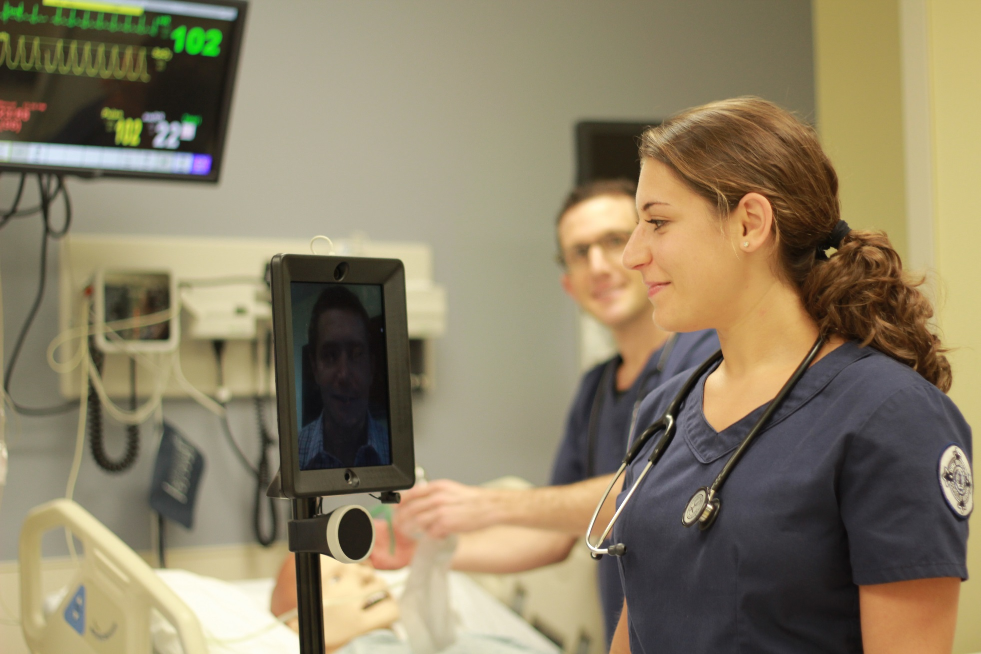
Visit: Double Robotics JAMMER
Notes:
We tested new models of care delivery using telepresence robots. We incorporated the robots into educational offerings first and are now rolling them out into Duke Hospital.

Slide 28
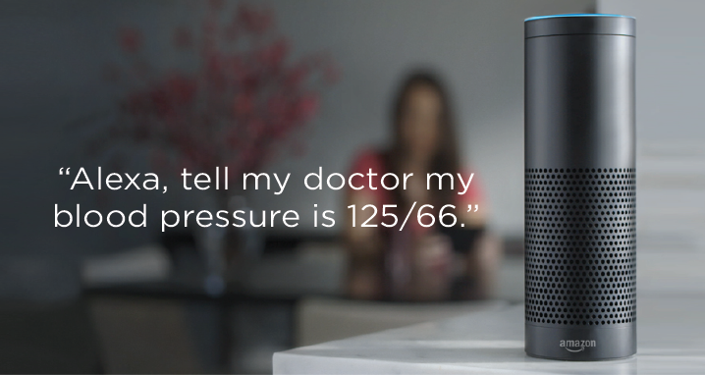

Slide 30
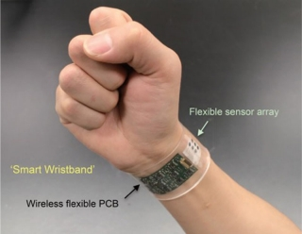
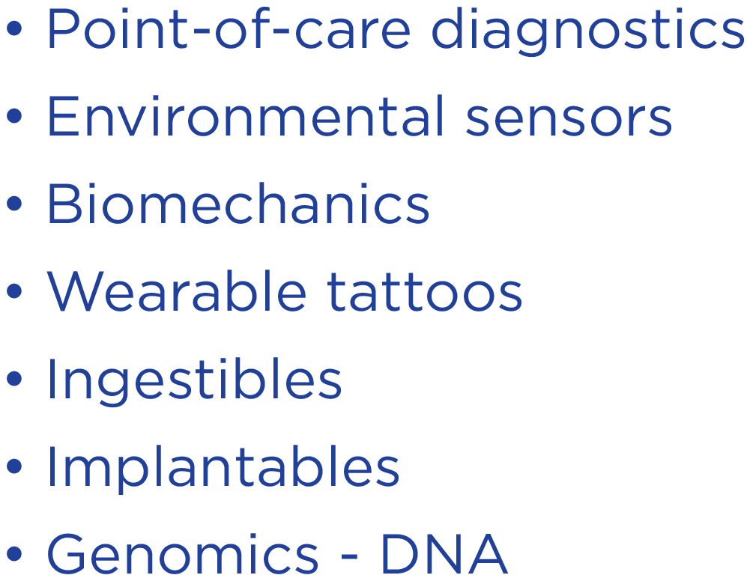
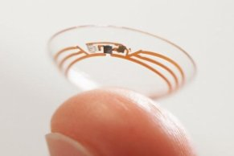

Slide 31
Collaborators & Team members
Angel Barnes
Qing Yang
Jackie Vaughn
Dori Steinberg
Daniel Hatch
Matthew Crowley
Allison Vorderstrasse
Anna Diane
Constance Johnson
Geoff Ginsburg
Susanne Haga
Lori Orlando
Karen Judge
Ellie Wood
Marissa Stroo
Katie McMillan
Ellie Wood
Corrine Voils
Many more…

Slide 32
References
Shaw, R.J., Bosworth, H.B., Silva, S., Lipkus, I.M., Davis, L.L. Sha, R.S., Johnson, C.M. (2013). Mobile health messages help sustain recent weight loss. The American Journal of Medicine, 126(11), 1002-1009. PMID: 24050486. PMCID: PMC3820279
Shaw, R.J., McDuffie, J.R., Hendrix, C.C., Edie, A., Lindsey-Davis, L., Nagi, A., Kosinski, A.S., Williams, J.W. Jr. (2014). Effects of nurse-managed protocols in the outpatient management of adults with chronic conditions: A systematic review and meta-analysis. Annals of Internal Medicine, 161(2), 113-121. doi: 10.7326/M13-2567. PMID: 25023250
Shaw, R.J., Bonnet, J., Modarai, F., George, A., Shahsahebi, M. (2015). Mobile health technology for personalized primary care medicine. American Journal of Medicine, 128(6), 555-557. doi: 10.1016/j.amjmed.2015.01.005 PMID: 25613298
Shaw, R.J., Pollak, K., Zullig, L., Bennett, G., Hawkins, K., Lipkus, I. (2016). Feasibility and smokers’ evaluation of self-generated text messages to promote quitting. Nicotine & Tobacco Research, 18(1), doi: 10.1093/ntr/ntv268
Shaw, R.J., Steinberg, D., Bonnet, J., Modarai, F., George, A., Cunningham, T., Mason, M., Shahsahebi, M., Grambow, S.C., Bennett, G., Bosworth, H. (2016). Mobile health devices: Will patients actually use them? Journal of the American Medical Informatics Association, 1-5. DOI: 10.1093/jamia/ocv186
Jain, S. H., Powers, B. W., Hawkins, J. B., & Brownstein, J. S. (2015). The digital phenotype. Nature Biotechnology, 33(5), 462.
Coravos A, Goldsack J, C, Karlin D, R, Nebeker C, Perakslis E, Zimmerman N, Erb M, K: Digital Medicine: A Primer on Measurement. Digit Biomark 2019;3:31-71. doi: 10.1159/000500413
Hickey, K. T., Bakken, S., Byrne, M. W., Demiris, G., Docherty, S. L., Dorsey, S. G., ... & Moore, S. M. (2019). Precision health: Advancing symptom and self-management science. Nursing outlook.
Ferguson, C., Hickman, L., Wright, R., Davidson, P. M., & Jackson, D. (2018). Preparing nurses to be prescribers of digital therapeutics.
Cashion, A. K., & Grady, P. A. (2015). The national Institutes of health/national Institutes of nursing research intramural research program and the development of the national Institutes of health symptom science model. Nursing outlook, 63(4), 484-487.
Gambhir, S. S., Ge, T. J., Vermesh, O., & Spitler, R. (2018). Toward achieving precision health. Science translational medicine, 10(430), eaao3612.

Slide 33
