Slide 1
Bringing Simulation to Life by Integrating the INACSL Standards of Best Practice Margory Molloy, DNP, RN, CNE, CHSE Danett S. Cantey, MSN, RN, CNE, CHSE Adrienne Small, DNP, RN, CNE, CHSE Jacqueline Vaughn, BSN, RN, CHSE

Slide 2
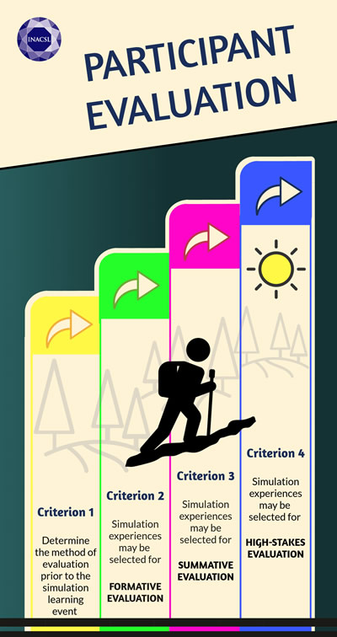
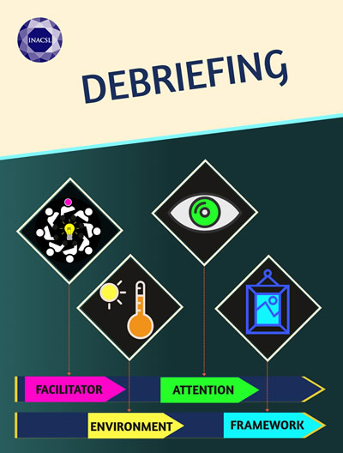
Standards of Best Practice (INACSL)
Debriefing
Participant Evaluation
Professional Integrity
Reference: INACSL Standards of Best Practice: SimulationSM
https://member.inacsl.org/i4a/pages/index.cfm?pageid=3407

Slide 3
Debriefing
All SBEs include a planned debriefing session aimed at improving future performance.
Criteria:
1. Competent facilitator
2. Conducted in an environment that is conducive to learning
3. Facilitated by a person(s) who observes the simulated experience
4. Based on a structured framework for debriefing
5. Congruent with the participants’ objectives and outcomes of the SBE

Slide 4
Competent Facilitator
Implement best practices in debriefing and facilitate reflection
Seek feedback using an established instrument
Actively maintain debriefing skills
Participate in initial and ongoing formal education
Notes:
Incorporation of the INACSL Standards of Best Practices: SimulationSM.
Using one of the many debriefing frameworks; Being mindful of how much time you have for debriefing. Asking questions that will get the learners to think about the “why” behind their own actions & communications or lack there of.
Seek feedback using an established instrument (Video record yourself and do a self-evaluation, get a peer to watch you live or video,
Actively maintain debriefing skills through active engagement in simulation-based experiences
Education: formal coursework/training and participates in ongoing continuing educational offerings, and/or targeted work with anexperienced mentor.1,13(see INACSL Standard:

Slide 5
Environment Conducive to Learning
Orientation, Code of conduct rules, Confidentiality
Utilize supportive demeanor to encourage discussion
Debrief immediately and in a separate room
Manage emotional and unexpected learner responses
Balance participation of all learners
Notes:
-The debrief is conducted in an environment that is conducive to learning and supports confidentiality, trust, open communication, self-analysis, feedback, and reflection.
-Orient the learners to debriefing process
-confidentiality of participants’ performance, the content of the simulation scenario, and the content of the debriefing discussion.
-Establish rules concerning constructive, honest, and respectful feedback.
-Acknowledge and validate the participants’ emotional response to the simulation-based experience and their primary concerns before engaging in reflection on and analysis of actions.
-Use verbal and nonverbal supportive demeanor to encourage discussion.
-Manage emotional and unexpected responses: Acknowledge and validate the participants’ emotional response to the simulation-based experience and their
primary concerns before engaging in reflection on and analysis of actions.
-Is there anything else you would like to discuss
-

Slide 6
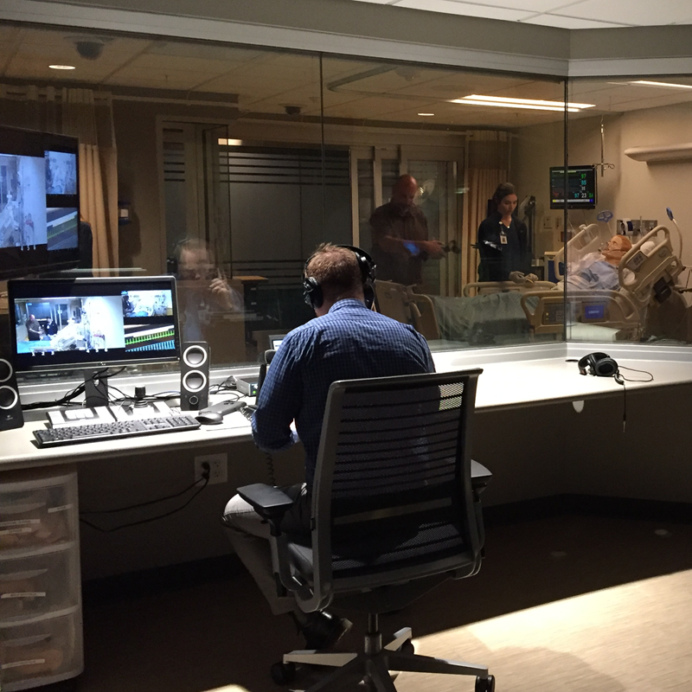
Facilitator Actively Observes the Simulation
Need concentrated attention and not distracted
Choose appropriate feedback technique
Provide formative feedback
Summarize learning to close gaps in knowledge and reasoning
Application to future clinical situations
Notes:
-Debriefer is not distracted by having to perform multiple functions and roles during the scenario (e.g., playing the voice of the patient, controlling the scenario, queuing the learning and evaluating the activities all at the same time and is able to focus on the most import role(s).
-Ensure adequate support to operate technology is available to allow the debriefer to focus primarily on learner evaluation (formative or summative).
-appropriate feedback technique (face-to-face, numeric, graphical transcripts of performance from equipment, video conferencing or video replay, checklists, scores, and other forms of feedback.
-Provide formative feedback based on scenario objectives, participants’ decisions and actions, including reinforcing positive behaviors, correcting misunderstandings, and clarifying cognitive frames that led to incorrect decisions.
**Provide concrete examples of participant performance.
-Assist participants in conceptualizing how the learning constructed during the simulation and debriefing can be applied to future clinical situations.

Slide 7
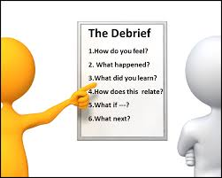
Frameworks for Debriefing
Gather, Analyze, Summarize (GAS)
Debriefing with Good Judgement
Promoting Excellence and Reflective Learning in Simulation (PEARLS)
Debriefing for Meaningful Learning (DML)
Plus-Delta
3D Model of Debriefing
OPT Model of Clinical Reasoning
Notes:
Includes the minimum phases of reaction, analysis, and summary.
Current frameworks available are GAS (gather, analyze, summarize), Debriefing with Good Judgment, PEARLS, Debriefing for Meaningful Learning (DML), Plus-Delta, 3D Model of Debriefing, and the OPT Model of Clinical Reasoning. Frameworks will continue to be developed that are appropriate to
be used during debriefing.

Slide 8
Common Debriefing Method
Pros – Cons – Alternatives
Plus (+) Delta Method
+ | Delta
Example of good behaviors/actions | Behaviors/actions that would change or improve in the future
Easier Task or behaviors | Behaviors or actions that were difficult

Slide 9
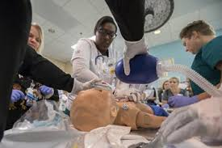
Factors to Consider in Debriefing
Objectives of the exercise
Complexity of the scenario
Experience level of the learners
Familiarity of learners with the environment
Time available for the session
Role of simulation in curriculum
Individual personalities and relationships

Slide 10
Debriefing starts with the “Prebriefing”
Prebriefing:
The instructor should be prepared:
Describe the purpose of the simulation
Review learning objectives
Describe the process of debriefing
The learner will in turn:
Know the expectations
Know the ground rules
To understand that learners will come with their own experiences and frames

Slide 11
Reflective Practice
Method used to scrutinize one’s own taken-for granted assumptions and professional work practices
The theory of reflective practice draws on cognitive science, social psychology, and anthropology
People make sense of external stimuli through internal cognitive “frames” (or frame of reference, mental models, etc.), internal images or external reality
Rudolph, JW, Simon, R, Dufresne, RL, Raemer, DB. There’s No Such Thing as “Nonjudgmental” Debriefing: A Theory and Method for Debriefing with Good Judgment. Simulation in Healthcare, 2006

Slide 12
Practical Aspects of Debriefing
Physical Setting
Comfortable and private
Think about seating style
In-situ simulations
Emotional Setting
Prebrief – set the expectations
(Confidentiality, role of the facilitator, role of the participant,
Ground rules for a civil & safe-learning environment)

Slide 13
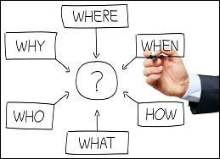
Debriefing Practical Aspects- Tips
Questioning:
Open ended, non-judgmental
Begin questions with what, how, or why to encourage deeper discussion
Follow-up on participant comments
Make the participant feel their contribution is important
Consider the emotional impact of the exercise

Slide 14
Debriefing Practical Aspects- Tips (continued)
Include ALL participants
Reflect questions back to the participants
Use silence appropriately (10 seconds is NOT too long)
Be observant to the body language of the group or individual
Understand group dynamics
Notes:
Bring the quiet, withdrawn participant into the discussion (they have thoughts about what is happening, but may have trouble sharing)

Slide 15
Debriefing Traps…
Too much instructor talking
“telling” to teach
Avoid “personal” evaluation before the discussion ends
Too much medical/technical
Too judgmental/condescending
Avoid interruptions
Avoid “guess what I am thinking?”

Slide 16
Opening lines…
How do you feel that went?
What were your first impressions when you arrived on scene?
What were your thoughts about the handoff report?
Who/what/where are other sources of information about the patient/scenario?
Who was the leader?
How did you ask for help?

Slide 17
Prompting discussion
Repeating what the participant said to help reiterate a point, or open a discussion
Relate the event to real life
If participants are apathetic, address questions to them by name or go around the room in sequence
Consider starting the debrief by calling on someone other than the primary participant

Slide 18
Questions?
What were the pros, cons, or alternatives to an action?
If this were to happen in real life, what might you do in the future?
Did you find the scenario challenging?

Slide 19
Fixation Errors
What did you think was happening?
Has anything like this happened in real life?
What made it difficult to think of other options or possibilities at the time?

Slide 20
Debrief Wrap-up
How did you hand over the scenario?
What were the take home messages of the scenario (+ delta or pro, cons, alternatives can help here)?
Review the aim of the simulation and how this can help in real-life practice
Give the participants the opportunity to discuss/re-contact with you if there are further questions

Slide 21
Professional Integrity
Professional integrity is demonstrated an upheld by all involved in SBE.
Criteria:
Foster and role model attributes of professional integrity at all times
Follow standards of practice, guidelines, principles, and ethics of one’s profession
Create and maintain a safe learning environment
Require confidentiality of the performances and scenario content based on institution policy and procedures
Notes:
Spirit of inquiry and not attacking
Remaining nonjudgmental
Not talking down to the students,
Not shaming the students
Neutral body language and facial expressions

