Slide 1




DUKE CONTINUING EDUCATION PLANNING MONTHLY SERIES 2024
Notes:
https://ja.dh.duke.edu/duke-continuing-education-planning-monthly-series-2023

Slide 2
You’re Approved Now what !

Slide 3
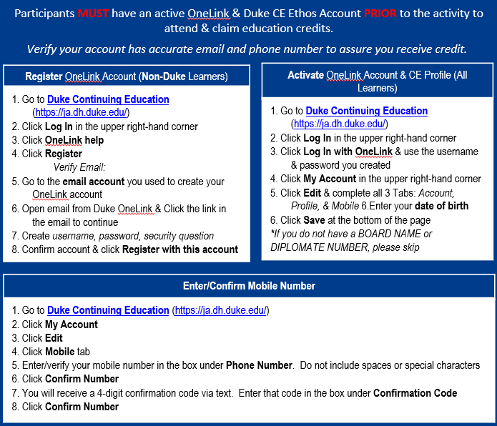
Mark your attendance!
Text RUGVAL to 919.213.8033 & send (active for 24hr only)
Learner expectations to Assure Attendance is Documented:
Duke CE Profile must be activated & confirmed with your mobile number to use Text Attendance SMS

Slide 4
Mission Statement
The Mission of The Continuing Education Department is to act as consultants in the Development, Propagation, and Implementation of Educational Programming for the Duke University Health System and its esteemed affiliates. We ensure that all Education is rooted in evidence-based practice, Health System Data, and equitably benefits/impacts all members of the Health Care Team.

Slide 5
OBJECTIVES:
Review Logos
Discuss forms needed to maintain approval
Review approved emails for each course type
Discuss Credit Types
Interactive Questions

Slide 6





Logos
Notes:
The top logos are from our website, they are correctly presented. Both are square or rectangular shaped and they are legible.
The bottom logos are incorrect! The first one to the left is barely visible and the right one looks cool but it does not accurately represent the IACET logo, therefore the “cool one” is wrong too.

Slide 7
Common forms we may ask for…

Slide 8
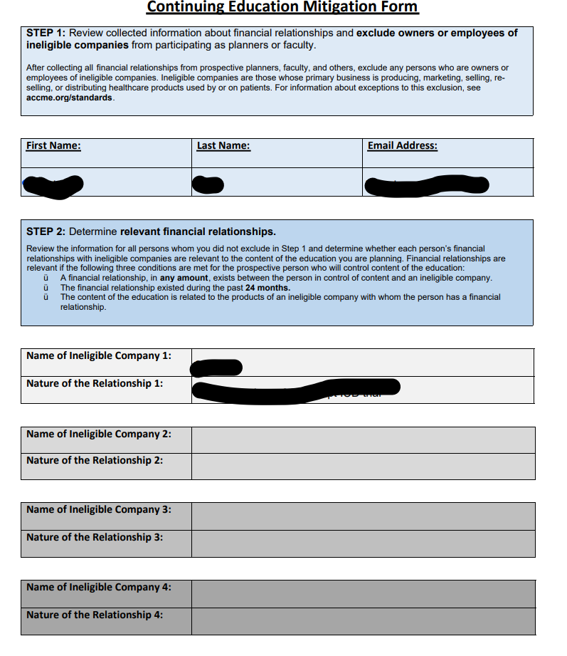
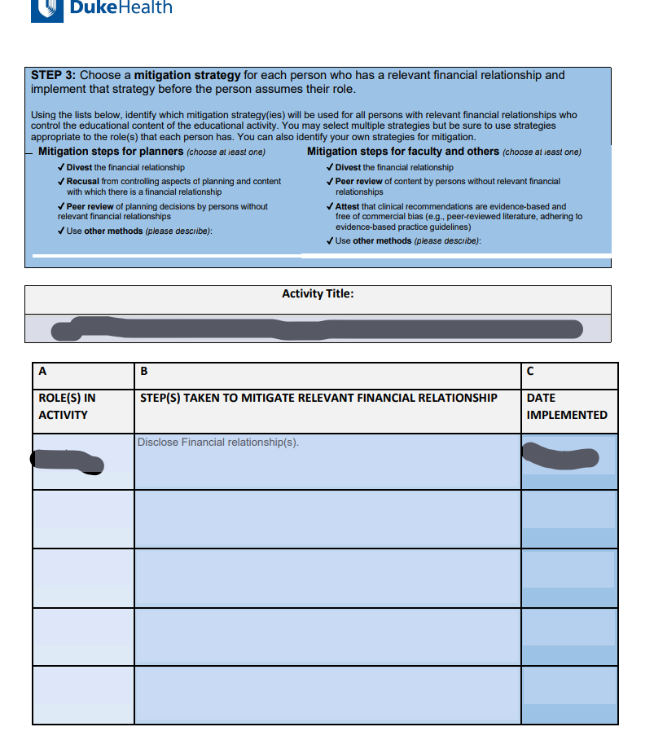
Mitigation Form
Notes:
A mitigation form is used when a speaker has financial relationships. Speakers are asked to list financial relationships on this form and our office will conclude what steps are needed to mitigate the relevant financial relationship. Typically we will ask for the speaker to disclose financial relationships. Ways to disclose can include written form on a slide show or verbally presented. If we feel the financial relationship may cause bias but we need a professional to ensure it doesn’t we will ask for a peer review for to be completed.

Slide 9
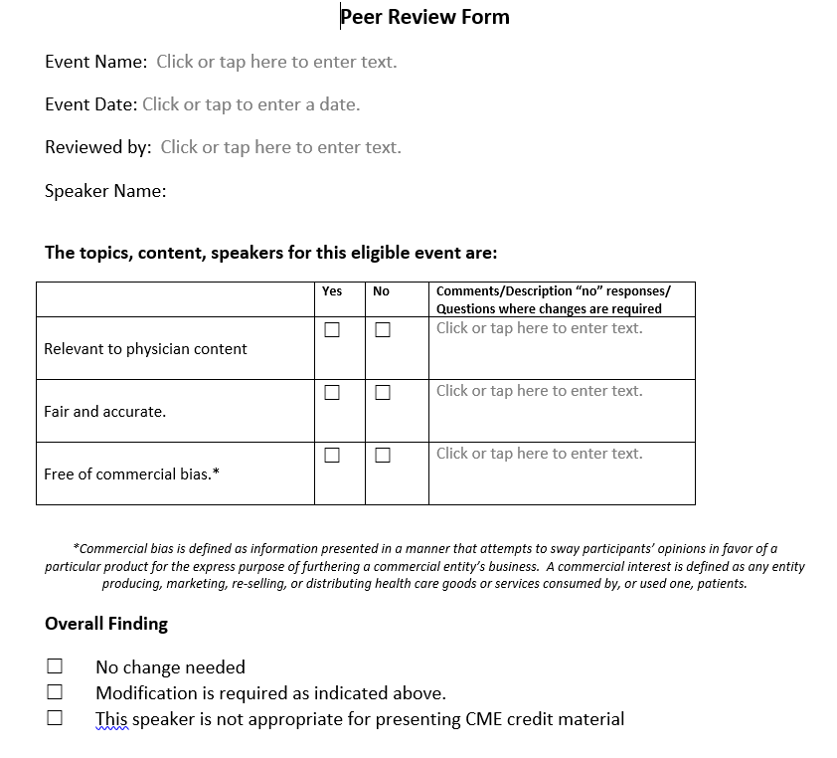
Peer review form
Notes:
The peer review form must be completed by a physician in the same discipline as the speaker/ or course content. This person will need to attest that there is no bias in the content by reviewing the content and completing this document.

Slide 10
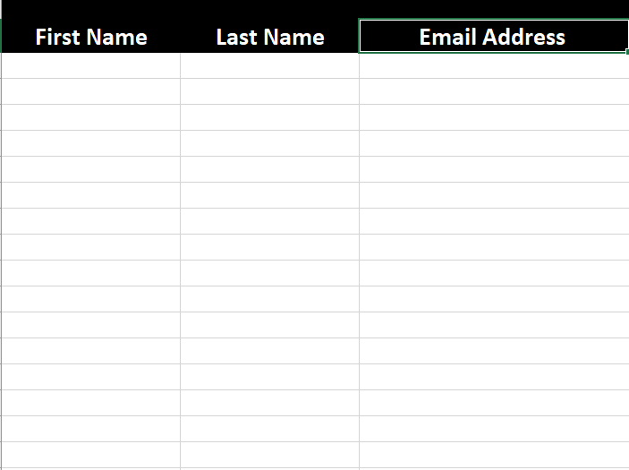

Attendance Roster

Slide 11
Course Types
Live Activity
Enduring Activity
Regularly Scheduled Series(RSS)
Notes:
We have three types of courses, Lives Activites, Eduring Activities and Regularly Scheduled Series. Today, we will discuss what is needed from each course type once the application is approved.

Slide 12
Approved Emails
Notes:
We have three types of courses, Lives Activites, Eduring Activities and Regularly Scheduled Series. Today, we will discuss what is needed from each course type once the application is approved.

Slide 13
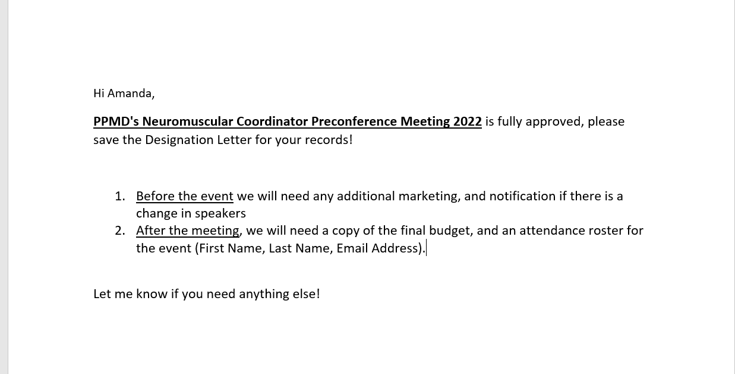

Your Live Activity was Approved!
Approval email
Attachments Included:
Designation letter
Mitigation forms (if applicable)
Peer Review Form (if applicable)
Register OneLink
Roster Template
Notes:
Please see the sample Approved Email. Attached in the Live Activity Email is the….

Slide 14

Designation letter

Slide 15
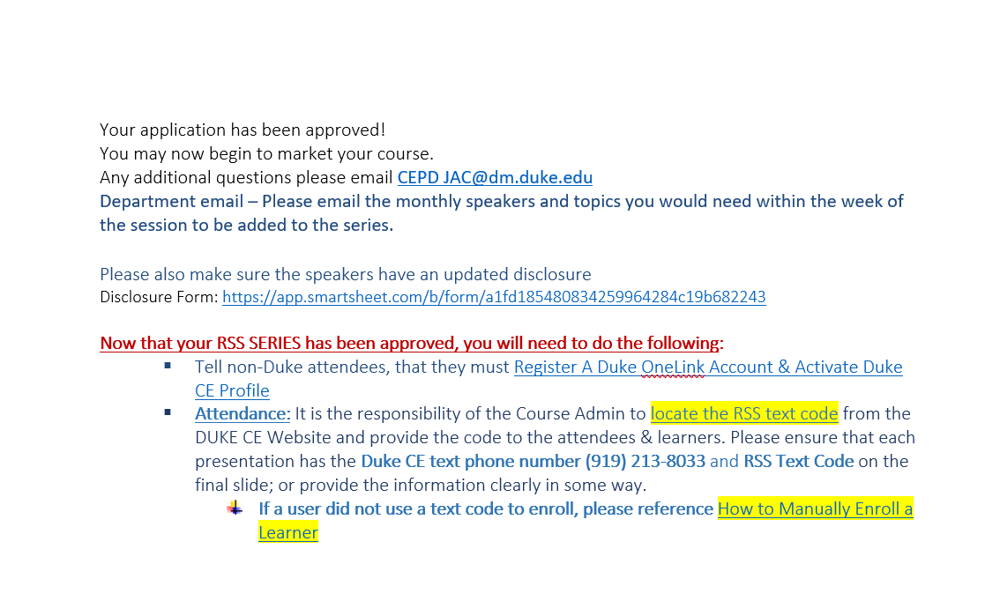
Regularly Scheduled Series Approval
Approval email
Attachments Included:
Designation letter
Mitigation forms for planning committee
Register OneLink
SMS codes

Slide 16
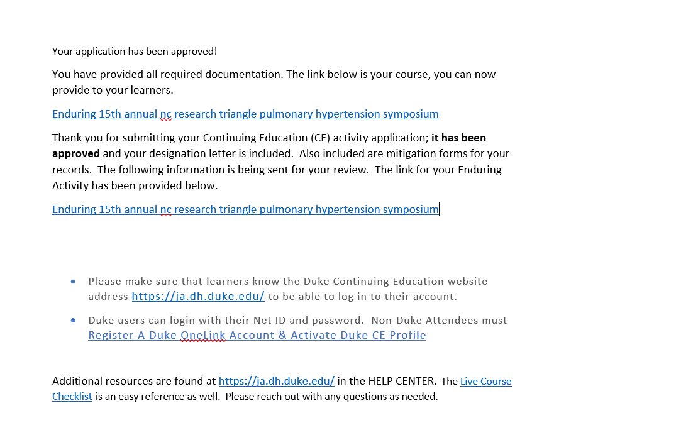
Enduring Activity Approval
Enduring content is ONLINE based learning.
*If it is not housed in our system (ETHOS/CE Website)
Designation Letter
Evaluations*
Attendance Roster*
Notes:
Enduring Activity emails include a link to your course in ETHOS and a designation letter. We want to ensure that the course is built correctly, it helps to have a second set of eyes so we encourage our associates to take a trial run through the course and make sure all content is presented accurately. If the course is not in our system but it has been approved for credit we then require quarterly Evaluations and Attendance rosters from the course. Please note that enduring activities last for 2 years on our website or outwardly housed.

Slide 17
Credit Types
Attendance: This credit can be awarded to anyone who is not eligible for any other credit listed below.
JA Credit –AH: Awarded to ( ex. Nurse, NP,
Psychologist, Anesthesia Assistant, Physical Therapist, etc.)
AMA PRA Category 1 Credit/Child of JA Credit: Awarded to Physicians,
Residents, Fellows, NP, PA, Psychiatrists
MOC: Requires additional documents be completed after approval.
Documents must be turned in within 30 days after each session if approved for an RSS.
Awarded to Physicians only ( board fields include, ABIM, ABA, ABPath,
ABOHNS, ABP, & ABS)
ACPE- Pharmacist/Pharmacy Tech: Awarded to Pharmacist and Pharmacy Technicians,
Credit MUST be claimed within 60 days after sessions/course, please ensure all attendees have knowledge of this requirement.
ANCC: Awarded to Nurses Only.
IACET CEU: Awarded to a variety of Allied Health Professionals. IACET credit is calculated to the tenth of the credit hours. ( for ex. 1.00 credits awarded is 0.10 credits awarded in IACET. )

Slide 18
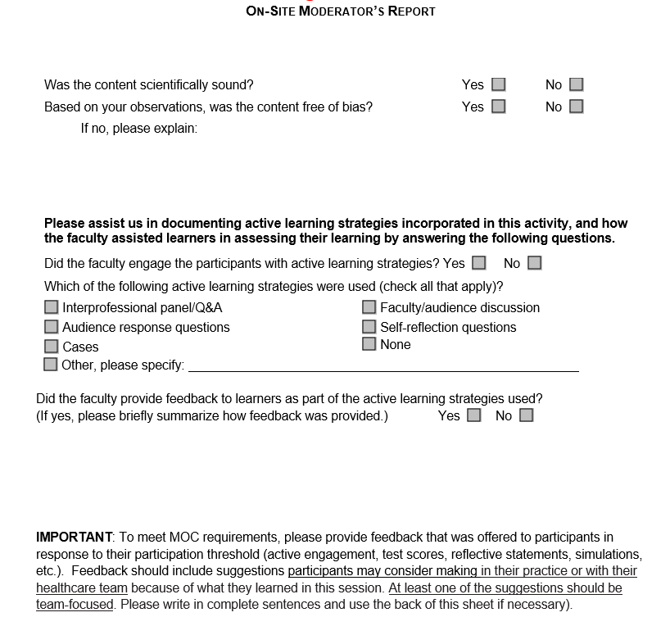
MOC: ON-SITE MODERATOR’S REPORT
Notes:
A Physician would fill these documents out. The physician would need to be in the same discipline or one of the disciplines of the MOC awarded. The physician cannot be on the planning committee

Slide 19
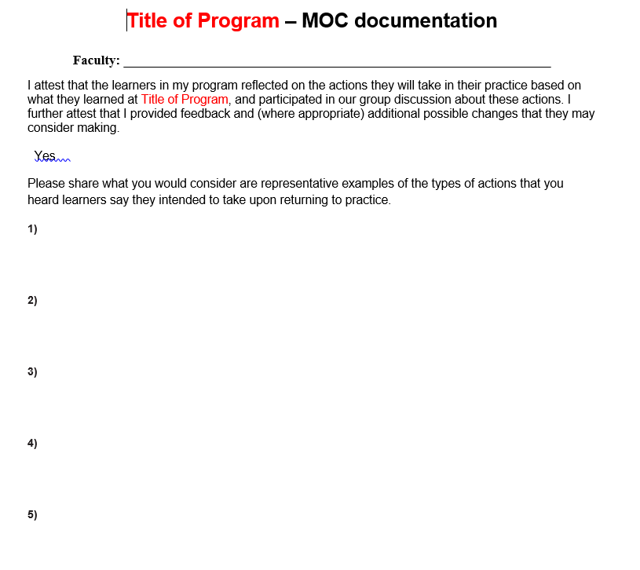
MOC DOCUMENTATION

Slide 20

You’re Approved! True or False
Regularly Scheduled Series need attendance rosters.
A designation letter is attached to all approval emails.
Nurses can receive MOC too!
False
True
False

Slide 21
Mark your attendance!
Text RUGVAL to 919.213.8033 & send (active for 24hr only)
Learner expectations to Assure Attendance is Documented:
Duke CE Profile must be activated & confirmed with your mobile number to use Text Attendance SMS

Slide 22

Questions/Comments
Wrap Up

